Slide 1

What's new in C# 10
Quick Overview

Slide 2
Agenda
Record structs
Improvements of structure types
Interpolated string handlers
global using directives
File-scoped namespace declaration
Extended property patterns
Improvements on lambda expressions
Allow const interpolated strings
Record types can seal ToString()
Allow both assignment and declaration in the same deconstruction
CallerArgumentExpression attribute
Enhanced #line pragma
Warning wave 6

Slide 3
Record structs
Beginning with C# 9, you use the record keyword to define a reference type that provides built-in functionality for encapsulating data.
C# 10 allows the record class syntax as a synonym to clarify a reference type, and record struct to define a value type with similar functionality.
You can create record types with immutable properties by using positional parameters or standard property syntax.
mutable properties
public record struct Person_ValueType
{
public string FirstName { get; init; }
public string LastName { get; set; }
public override string ToString() => $"({LastName}, {FirstName})";
}
Or
public record struct DataMeasurement(string FirstName , string LastName );
Links
Value types - C# reference | Microsoft Learn
Records - C# reference | Microsoft Learn

Slide 4
Record structs Demo
public record struct Person_ValueType
{
public string FirstName { get; set; }
public string LastName { get; set; }
public override string ToString() => $"({LastName}, {FirstName})";
}
public record Person_ReferenceType //class is implied here
{
public string? FirstName { get; set; }
public string? LastName { get; set; }
public override string ToString() => $"({LastName}, {FirstName})";
}
public record struct Person_ValueType
{
public string FirstName { get; set; }
public string LastName { get; set; }
public override string ToString() => $"({LastName}, {FirstName})";
}

Slide 5
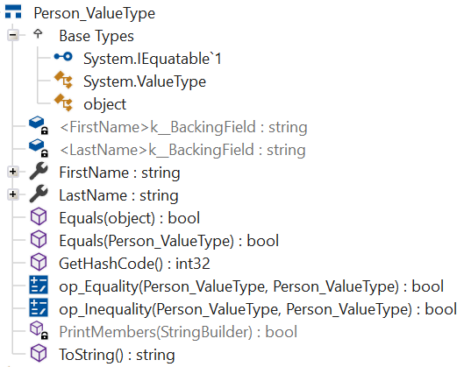
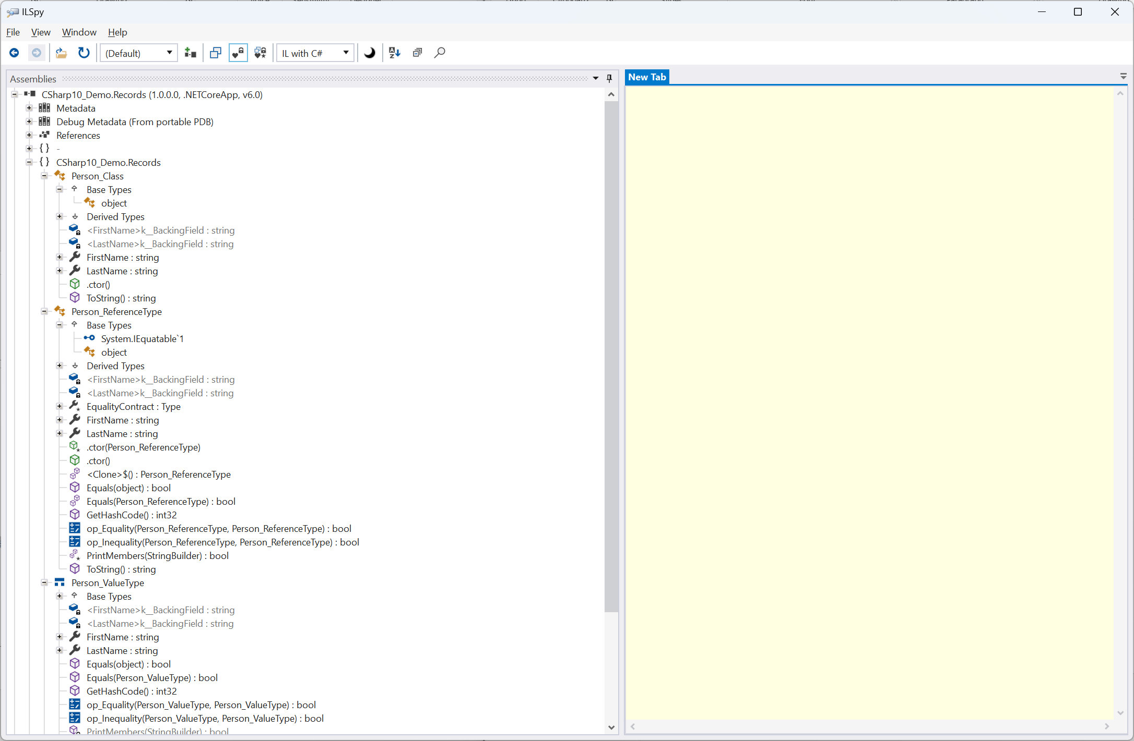
Using ILSpy you can quickly see how the code is complied differently

Slide 6
Record types can seal ToString()
In C# 10 and later, your implementation of ToString (inside a recored declaration) may include the sealed modifier, which prevents the compiler from synthesizing a ToString implementation for any derived records.
You can do this to create a consistent string representation throughout a hierarchy of record types.
public record Person_ReferenceType
{
public string? FirstName { get; set; }
public string? LastName { get; set; }
public override sealed string ToString() => $"({LastName}, {FirstName})";
}

Slide 7
Improvements of structure types
C# 10 introduces the following improvements related to structure types:
You can declare an instance parameterless constructor in a structure type and initialize an instance field or property at its declaration.
public readonly struct Measurement
{
public Measurement()
{
Value = double.NaN;
Description = "Undefined";
}
public Measurement(double value, string description)
{
Value = value;
Description = description;
}
public double Value { get; init; }
[DefaultValue("Not Provided")]
public string Description { get; init; }
public override string ToString() => $"{Value} ({Description})";
}
var m1 = new Measurement();
Links
Structure types - C# reference | Microsoft Learn
Default values of C# types - C# reference | Microsoft Learn

Slide 8
Improvements of structure types [continued]
C# 10 introduces the following improvements related to structure types:
A left-hand operand of the with expression can be of any structure type or an anonymous (reference) type.
using System;
public class InheritanceExample
{
public record Point(int X, int Y);
public record NamedPoint(string Name, int X, int Y) : Point(X, Y);
public static void Main()
{
Point p1 = new NamedPoint("A", 0, 0);
Point p2 = p1 with { X = 5, Y = 3 };
Console.WriteLine(p2 is NamedPoint); // output: True
Console.WriteLine(p2); // output: NamedPoint { X = 5, Y = 3, Name = A }
}
}
Links
with expression - C# reference | Microsoft Learn

Slide 9
Custom Interpolated string handlers $”{[How to handle building string]}”
You can create a type that builds the resulting string from an interpolated string expression. The .NET libraries use this feature in many APIs.
C# 10 adds support for a custom interpolated string handler. An interpolated string handler is a type that processes the placeholder expression in an interpolated string.
Without a custom handler, placeholders are processed similar to String.Format.
Each placeholder is formatted as text, and then the components are concatenated to form the resulting string.
What constraints are on the format? Some examples include:
You may require none of the resulting strings are greater than some limit, such as 80 characters. You can process the interpolated strings to fill a fixed-length buffer, and stop processing once that buffer length is reached.
An interpolated string handler can determine if the formatted string will be used, and only perform the necessary work if needed.

Slide 10
Interpolated string handlers The .NET libraries use this feature in many APIs.
var sb = new StringBuilder(); sb.Append($"Hello {args[0]}, how are you?");
Up until now, this would call the Append(string? value) overload with a newly allocated and computed string, appending that to the StringBuilder in one chunk.
However, Append now has a new overload Append(ref StringBuilder.AppendInterpolatedStringHandler handler)
This overload takes precedence over the string overload when an interpolated string is used as argument.

Slide 11
Global using directives
In C# 10 you can apply two modifiers to a using directive:
[Added in C#10] The global modifier has the same effect as adding the same using directive to every source file in your project.
global using <fully-qualified-namespace>;
The static modifier imports the static members and nested types from a single type rather than importing all the types in a namespace.
using static <fully-qualified-type-name>;
Links
using directive - C# Reference | Microsoft Learn

Slide 12
File-scoped namespace declaration
You can use a new form of the namespace declaration to declare that all declarations that follow are members of the declared namespace:
namespace MyNamespace;
This new syntax saves both horizontal and vertical space for namespace declarations.

Slide 13
Extended property patterns
C# 10 adds extended property patterns to make it easier to access nested property values in patterns.
For example, if we add an address to the Person record above, we can pattern match in both of the ways shown here:
object obj = new Person { FirstName = "Kathleen", LastName = "Dollard", Address = new Address { City = "Seattle" } };
if (obj is Person { Address: { City: "Seattle" } })
Console.WriteLine("Seattle");
if (obj is Person { Address.City: "Seattle" }) // Extended property pattern
Console.WriteLine("Seattle");
The extended property pattern simplifies the code and makes it easier to read, particularly when matching against multiple properties.

Slide 14
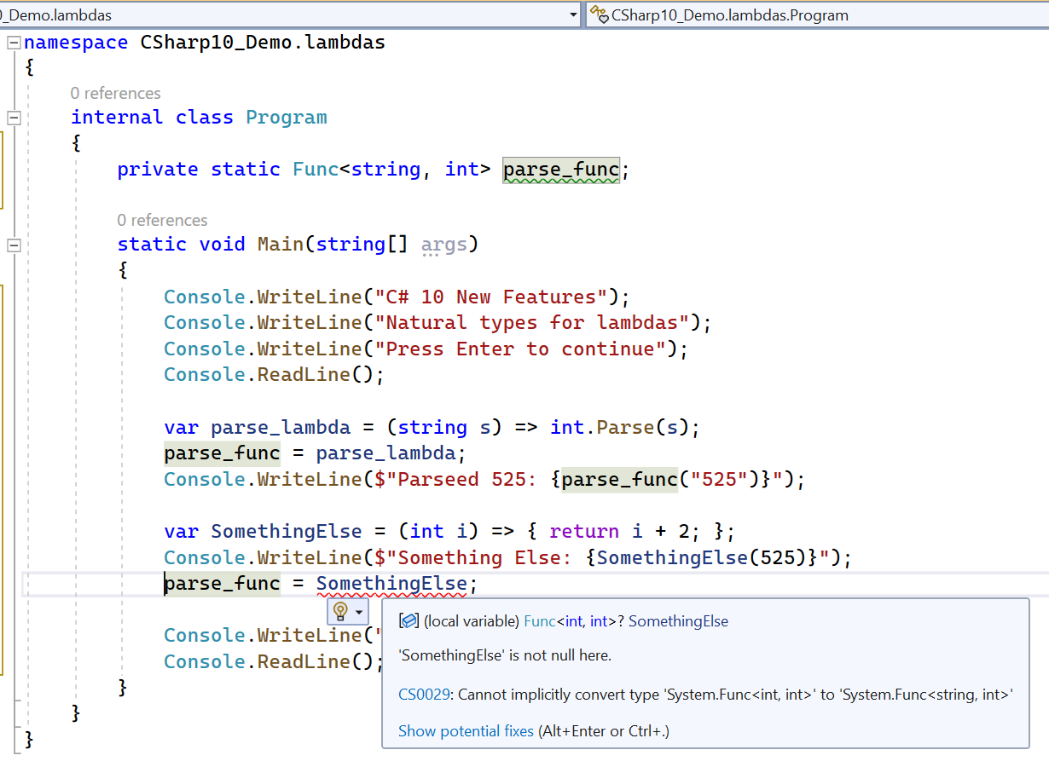
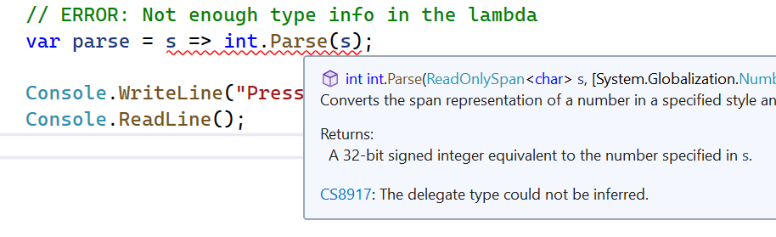
Improvements on lambda expressions
C# 10 includes many improvements to how lambda expressions are handled:
Lambda expressions may have a natural type, where the compiler can infer a delegate type from the lambda expression or method group.

Slide 15
Improvements on lambda expressions [continued]
C# 10 includes many improvements to how lambda expressions are handled:
Lambda expressions may declare a return type when the compiler can't infer it.
Attributes can be applied to lambda expressions.
var choose = (bool b) => b ? 1 : "two"; // ERROR: Can't infer return type
You can specify an explicit return type on a lambda expression.
The return type goes right before the parameters.
When you specify an explicit return type, the parameters must be parenthesized
var choose = object (bool b) => b ? 1 : "two"; // Func<bool, object>
You can put attributes on lambda expressions in the same way you do for methods and local functions.
Once again, the lambda’s parameter list must be parenthesized when there are attributes.
Func<string, int> parse = [Example(1)] (s) => int.Parse(s); var choose = [Example(2)][Example(3)] object (bool b) => b ? 1 : "two";
Just like local functions, attributes can be applied to lambdas if they are valid on AttributeTargets.Method.
Lambdas are invoked differently than methods and local functions, and as a result attributes do not have any effect when the lambda is invoked. However, attributes on lambdas are still useful for code analysis.

Slide 16
Allow const interpolated strings
In C# 10, const strings may be initialized using string interpolation if all the placeholders are themselves constant strings.
“In other words”
If all the holes of an interpolated string are constant strings, then the resulting string is now also constant.
This lets you use string interpolation syntax in more places, like attributes:
[Obsolete($"Call {nameof(Discard)} instead")]
Other types, like numeric or date values, cannot be used because they are sensitive to Culture, and can’t be computed at compile time.

Slide 17
Allow both assignment and declaration in the same deconstruction
This change removes a restriction from earlier versions of C#. Previously, a deconstruction could assign all values to existing variables, or initialize newly declared variables:
Old
New
// Initialization:
(int x, int y) = point;
// assignment:
int x1 = 0;
int y1 = 0;
(x1, y1) = point;
int x = 0;
(x, int y) = point;

Slide 18
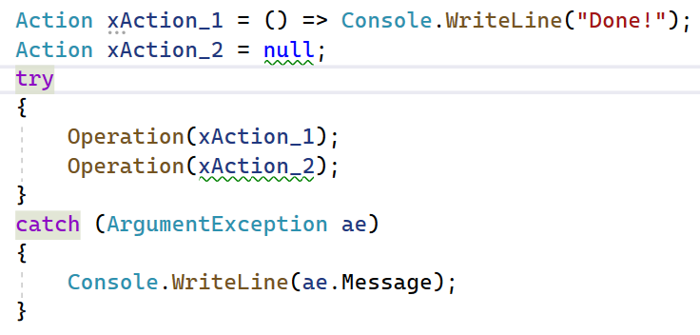
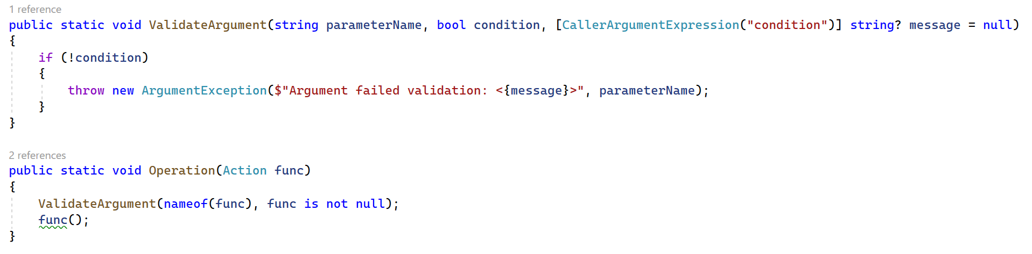
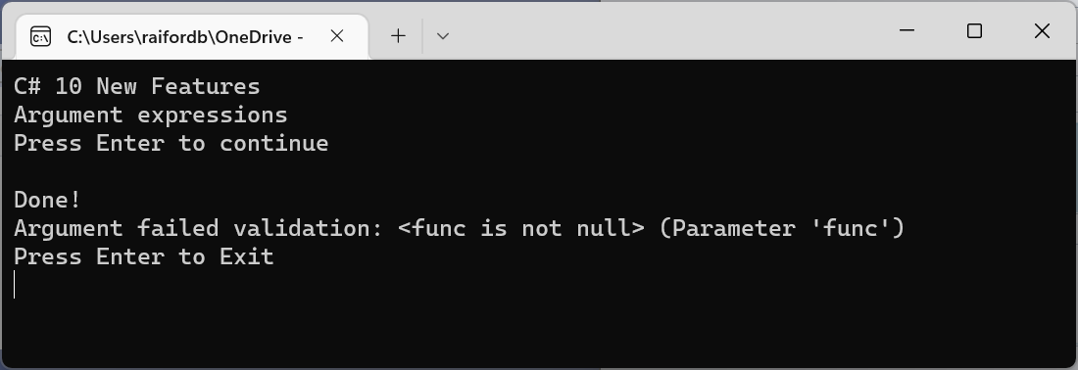
CallerArgumentExpression attribute
Use the System.Runtime.CompilerServices.CallerArgumentExpressionAttribute when you want the expression passed as an argument.
Diagnostic libraries may want to provide more details about the expressions passed to arguments.
By providing the expression that triggered the diagnostic, in addition to the parameter name, developers have more details about the condition that triggered the diagnostic.
Links
Attributes interpreted by the C# compiler: Tracking caller information | Microsoft Learn

Slide 19
Enhanced #line pragma
C# 10 supports a new format for the #line pragma.
The enhancements enable more fine-grained output in domain-specific languages (DSLs) like Razor.
The Razor engine uses these enhancements to improve the debugging experience.

Slide 20
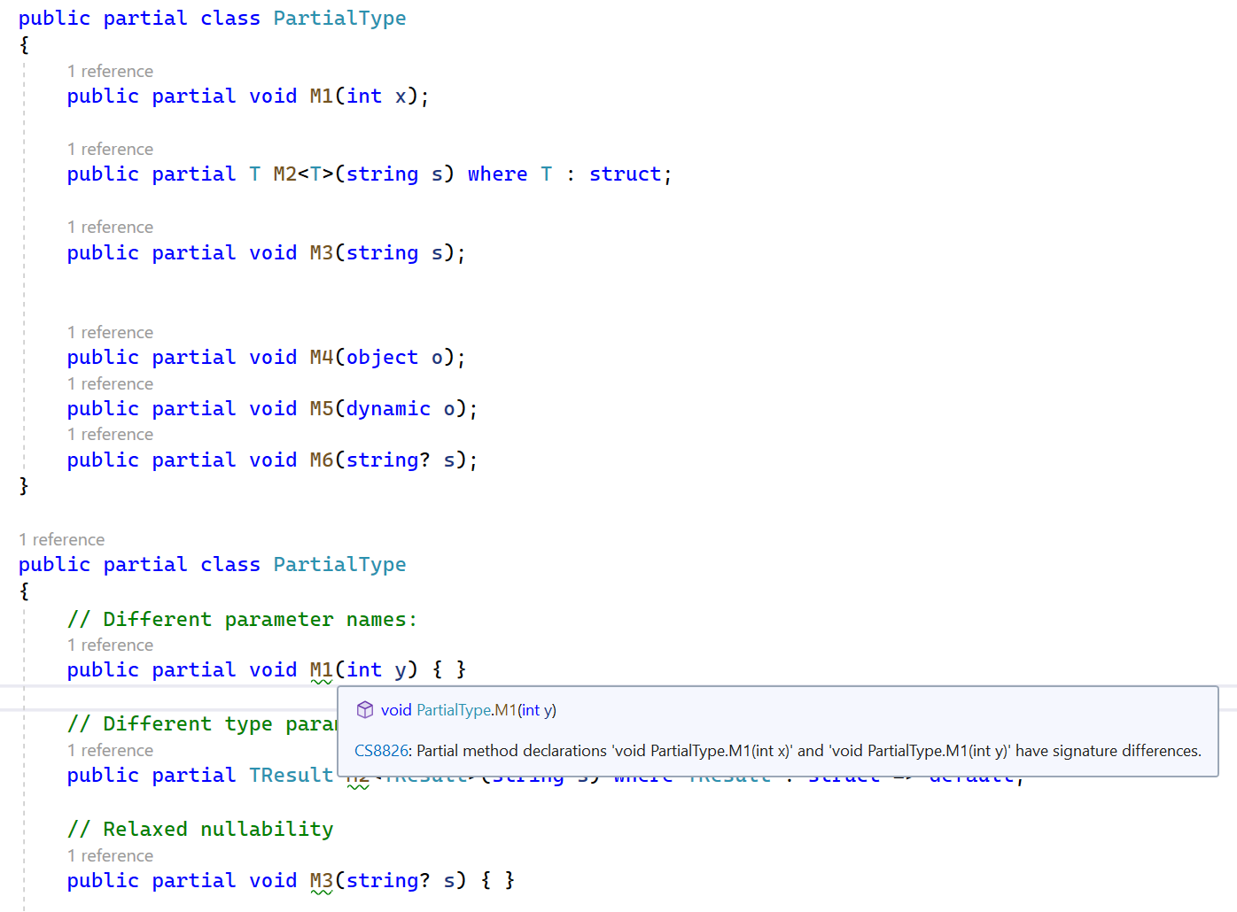
Warning wave 6
CS8826 - Partial method declarations have signature differences.
This warning corrects some inconsistencies in reporting differences between partial method signatures. The compiler always reported an error when the partial method signatures created different CLR signatures. Now, the compiler reports CS8826 when the signatures are syntactically different C#. Consider the following partial class:

Slide 21

Thank you

